Slide 1
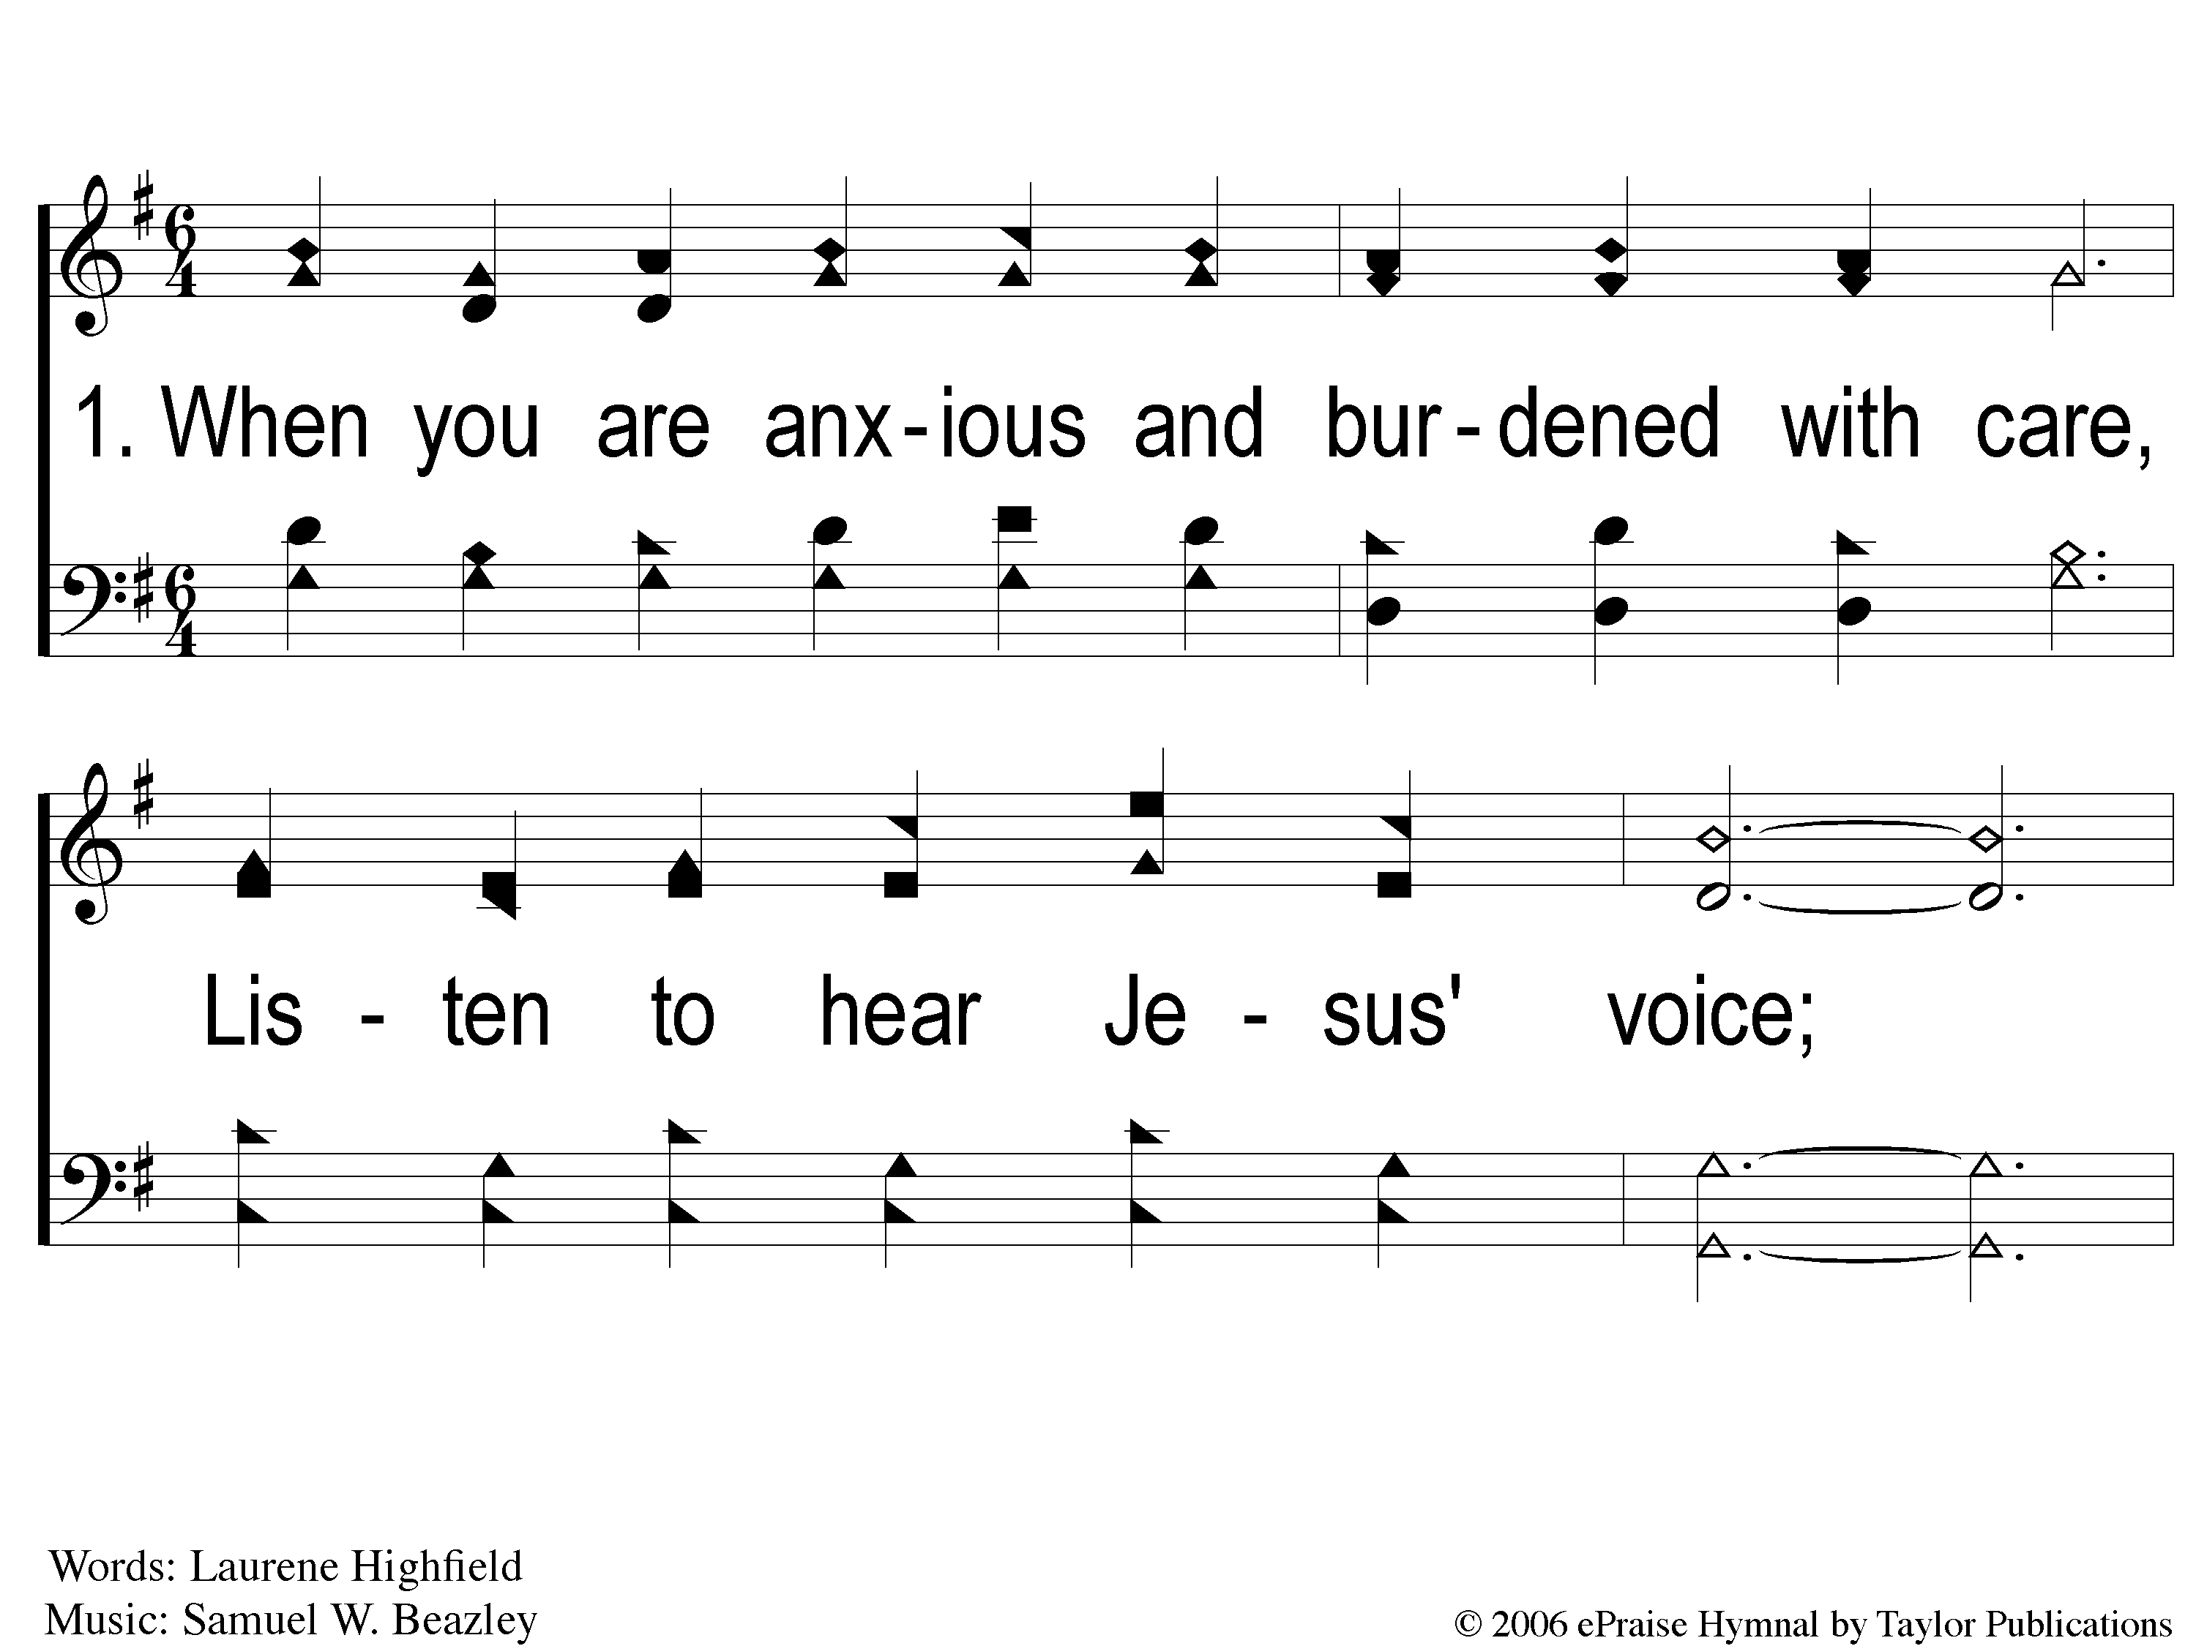
1-1 Cling to His Hand
Cling To His Hand
40

Slide 2
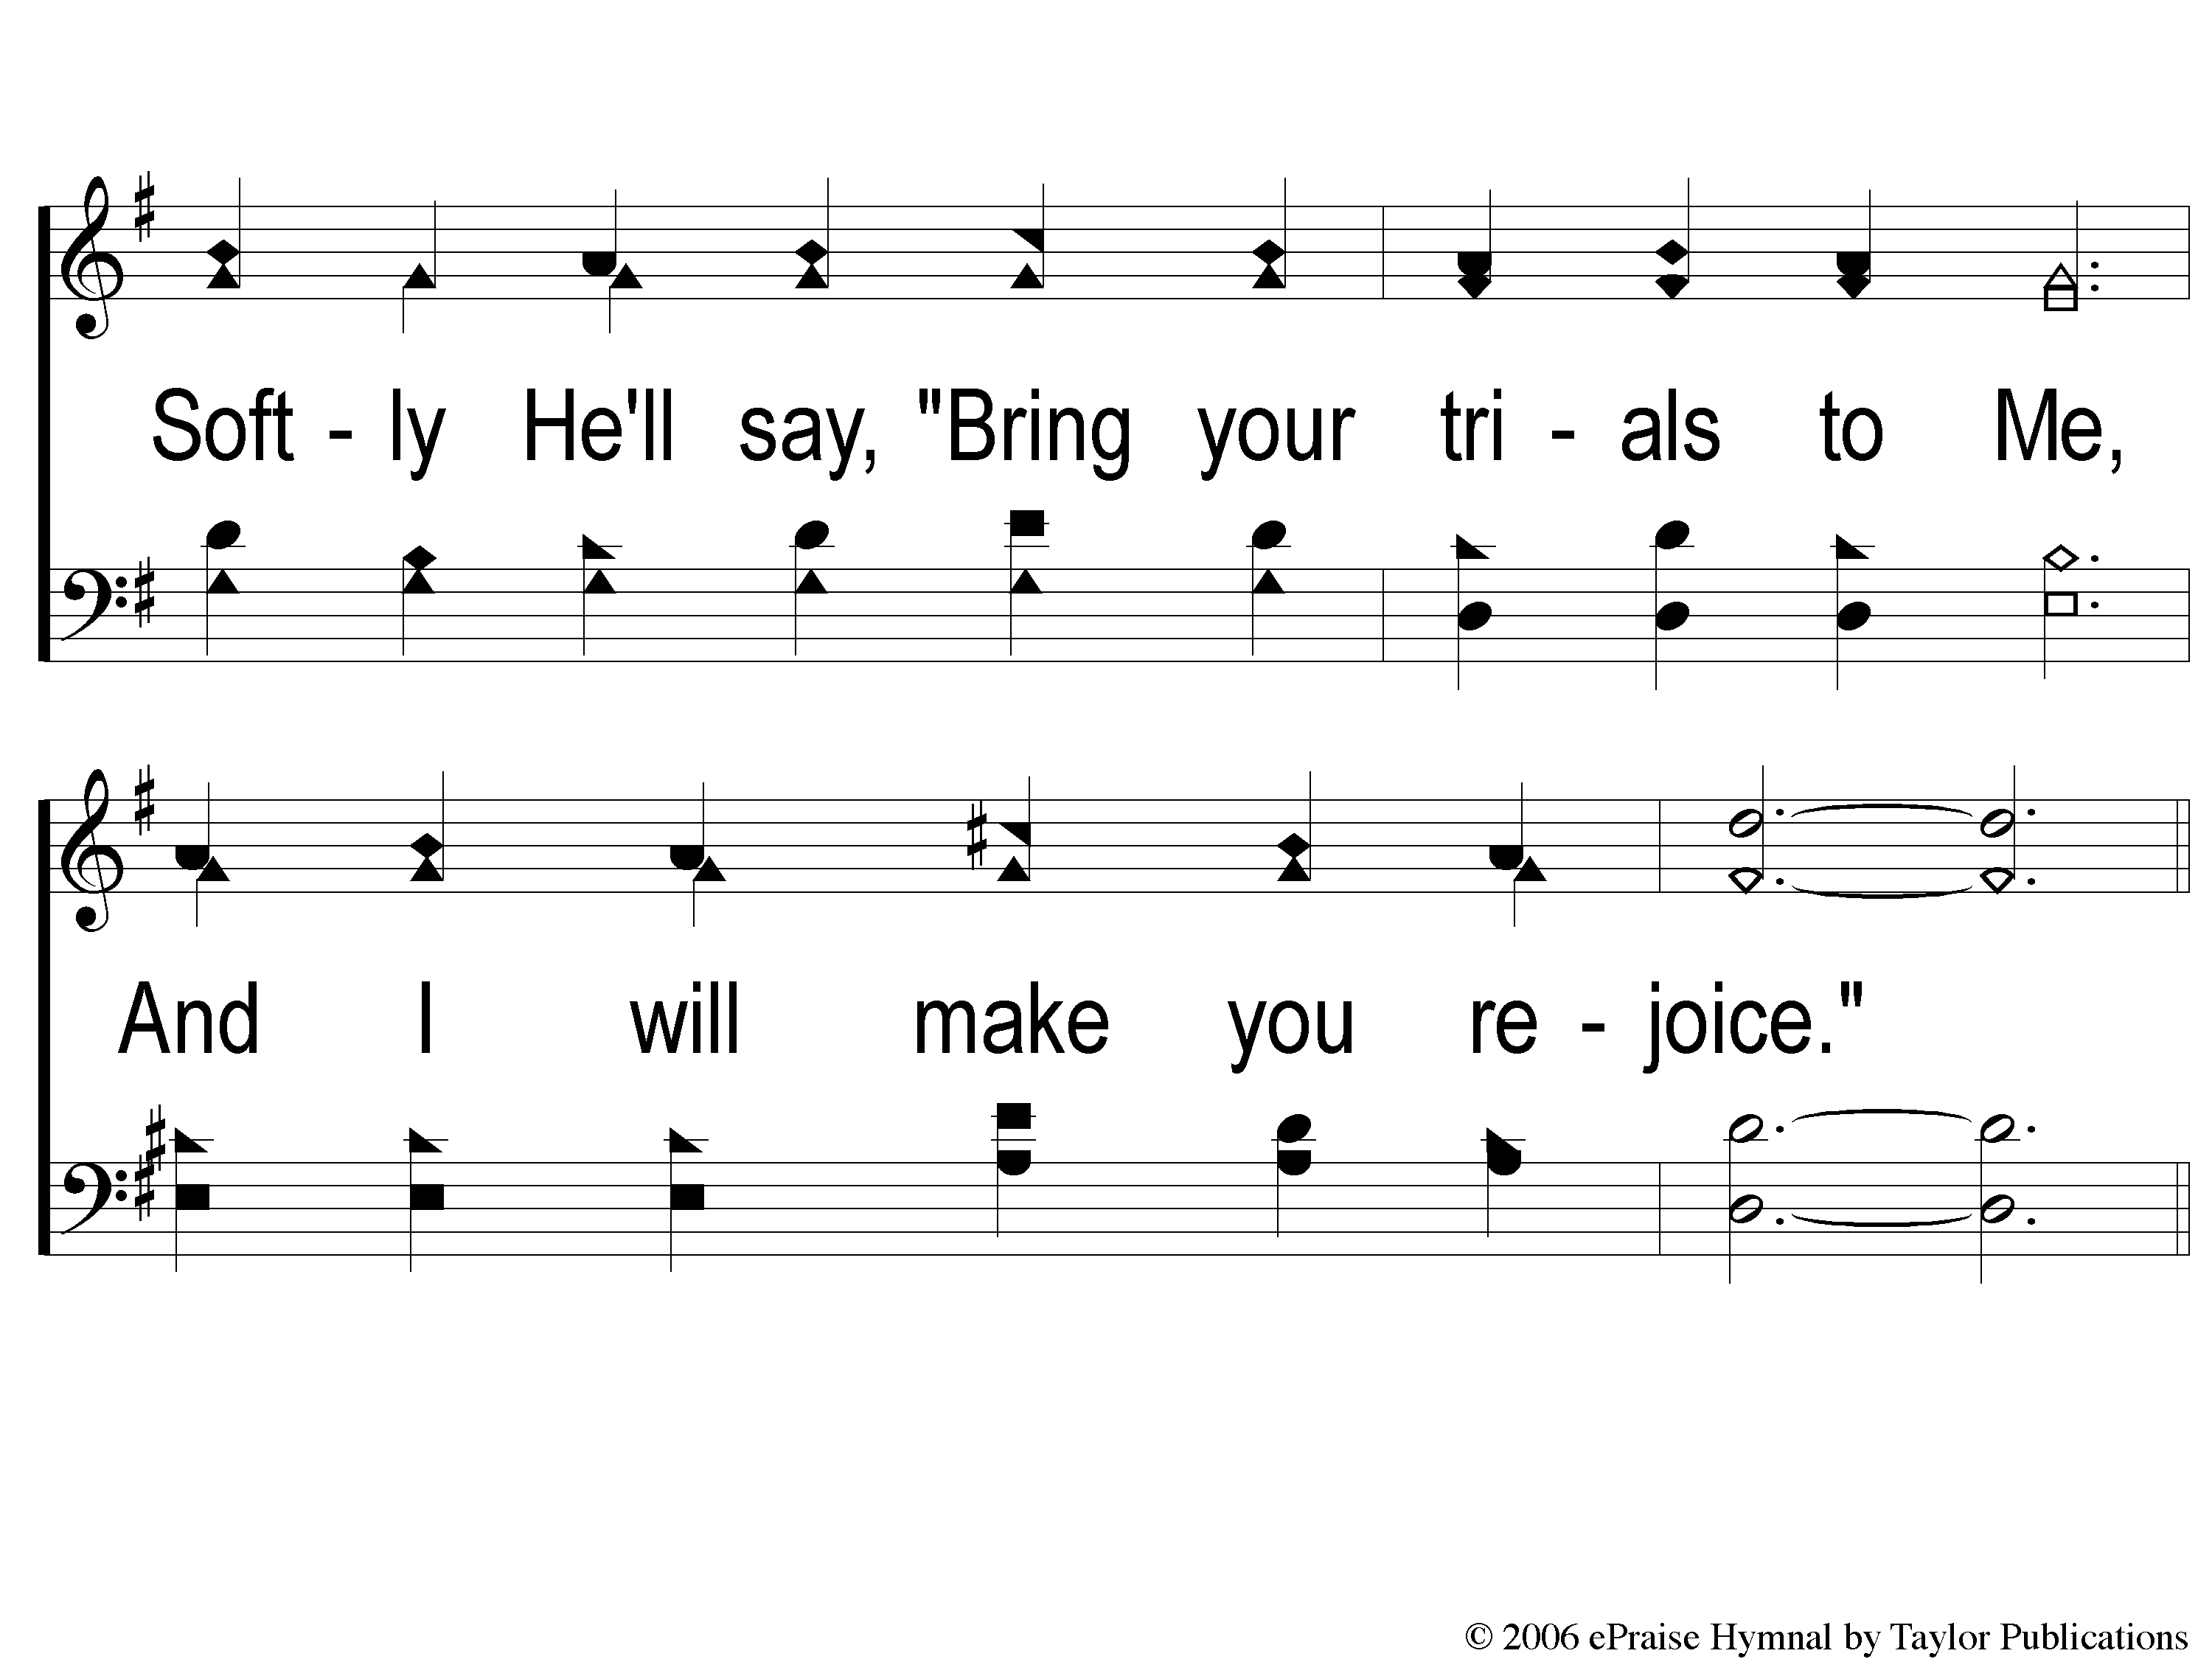
1-2 Cling to His Hand
Cling To His Hand
40

Slide 3
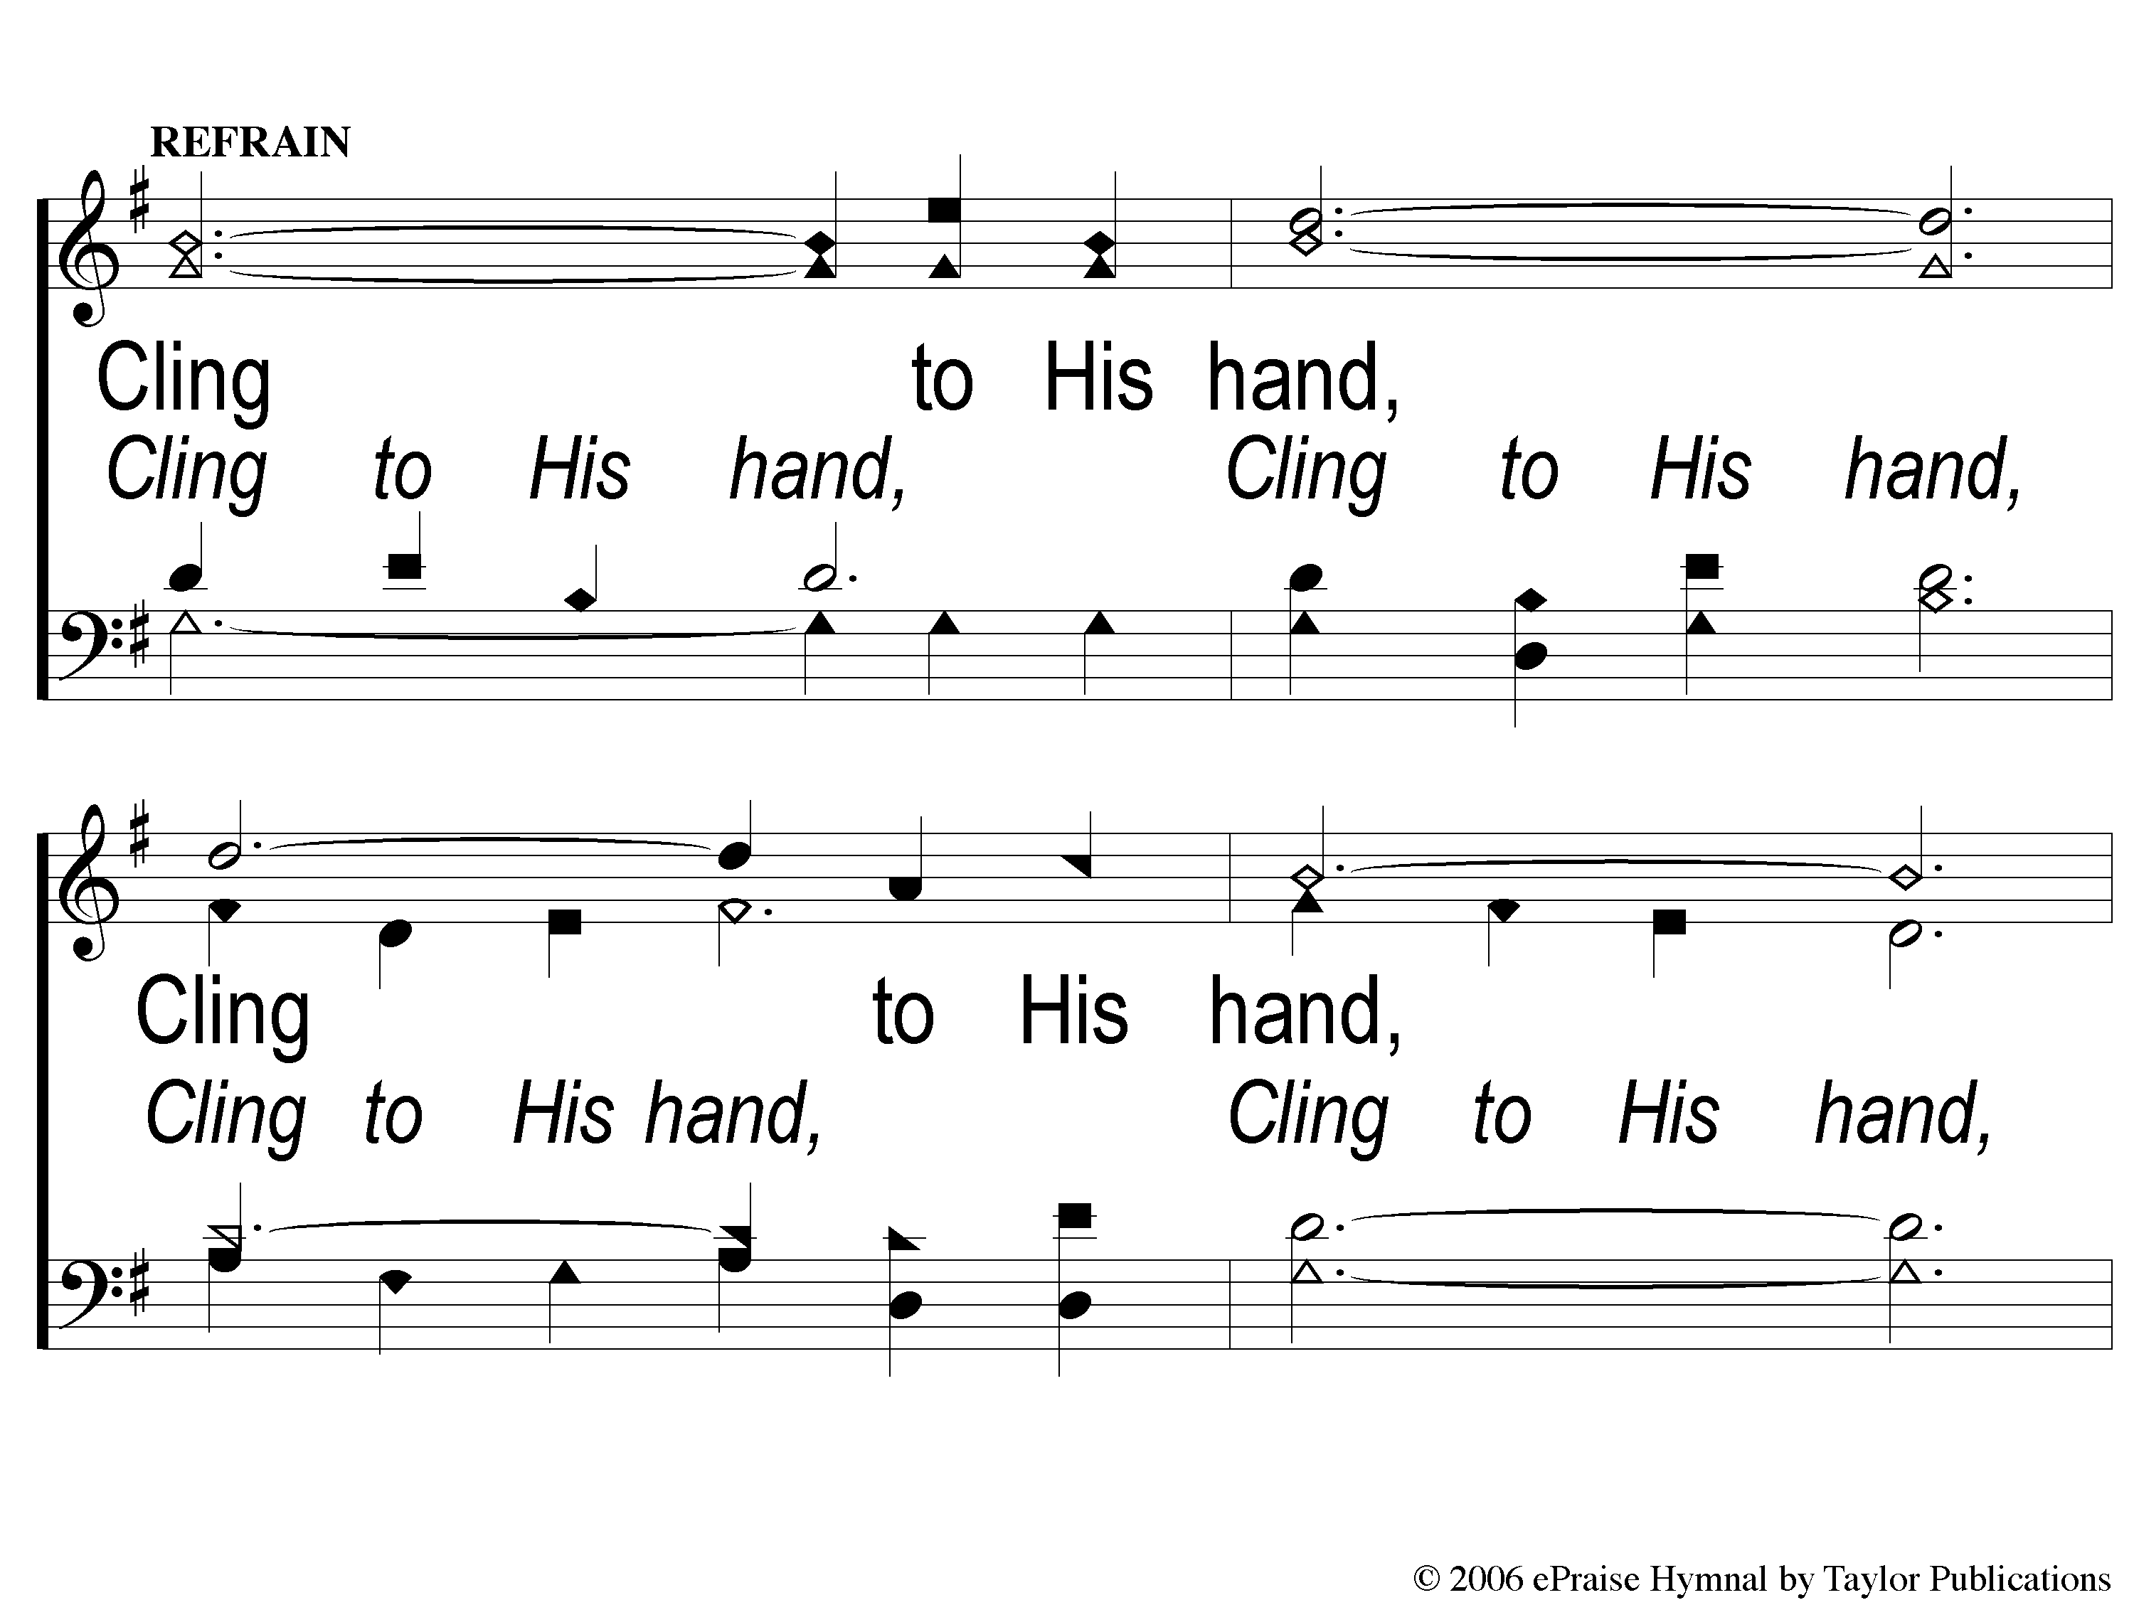
C-1 Cling to His Hand
Cling To His Hand
40

Slide 4
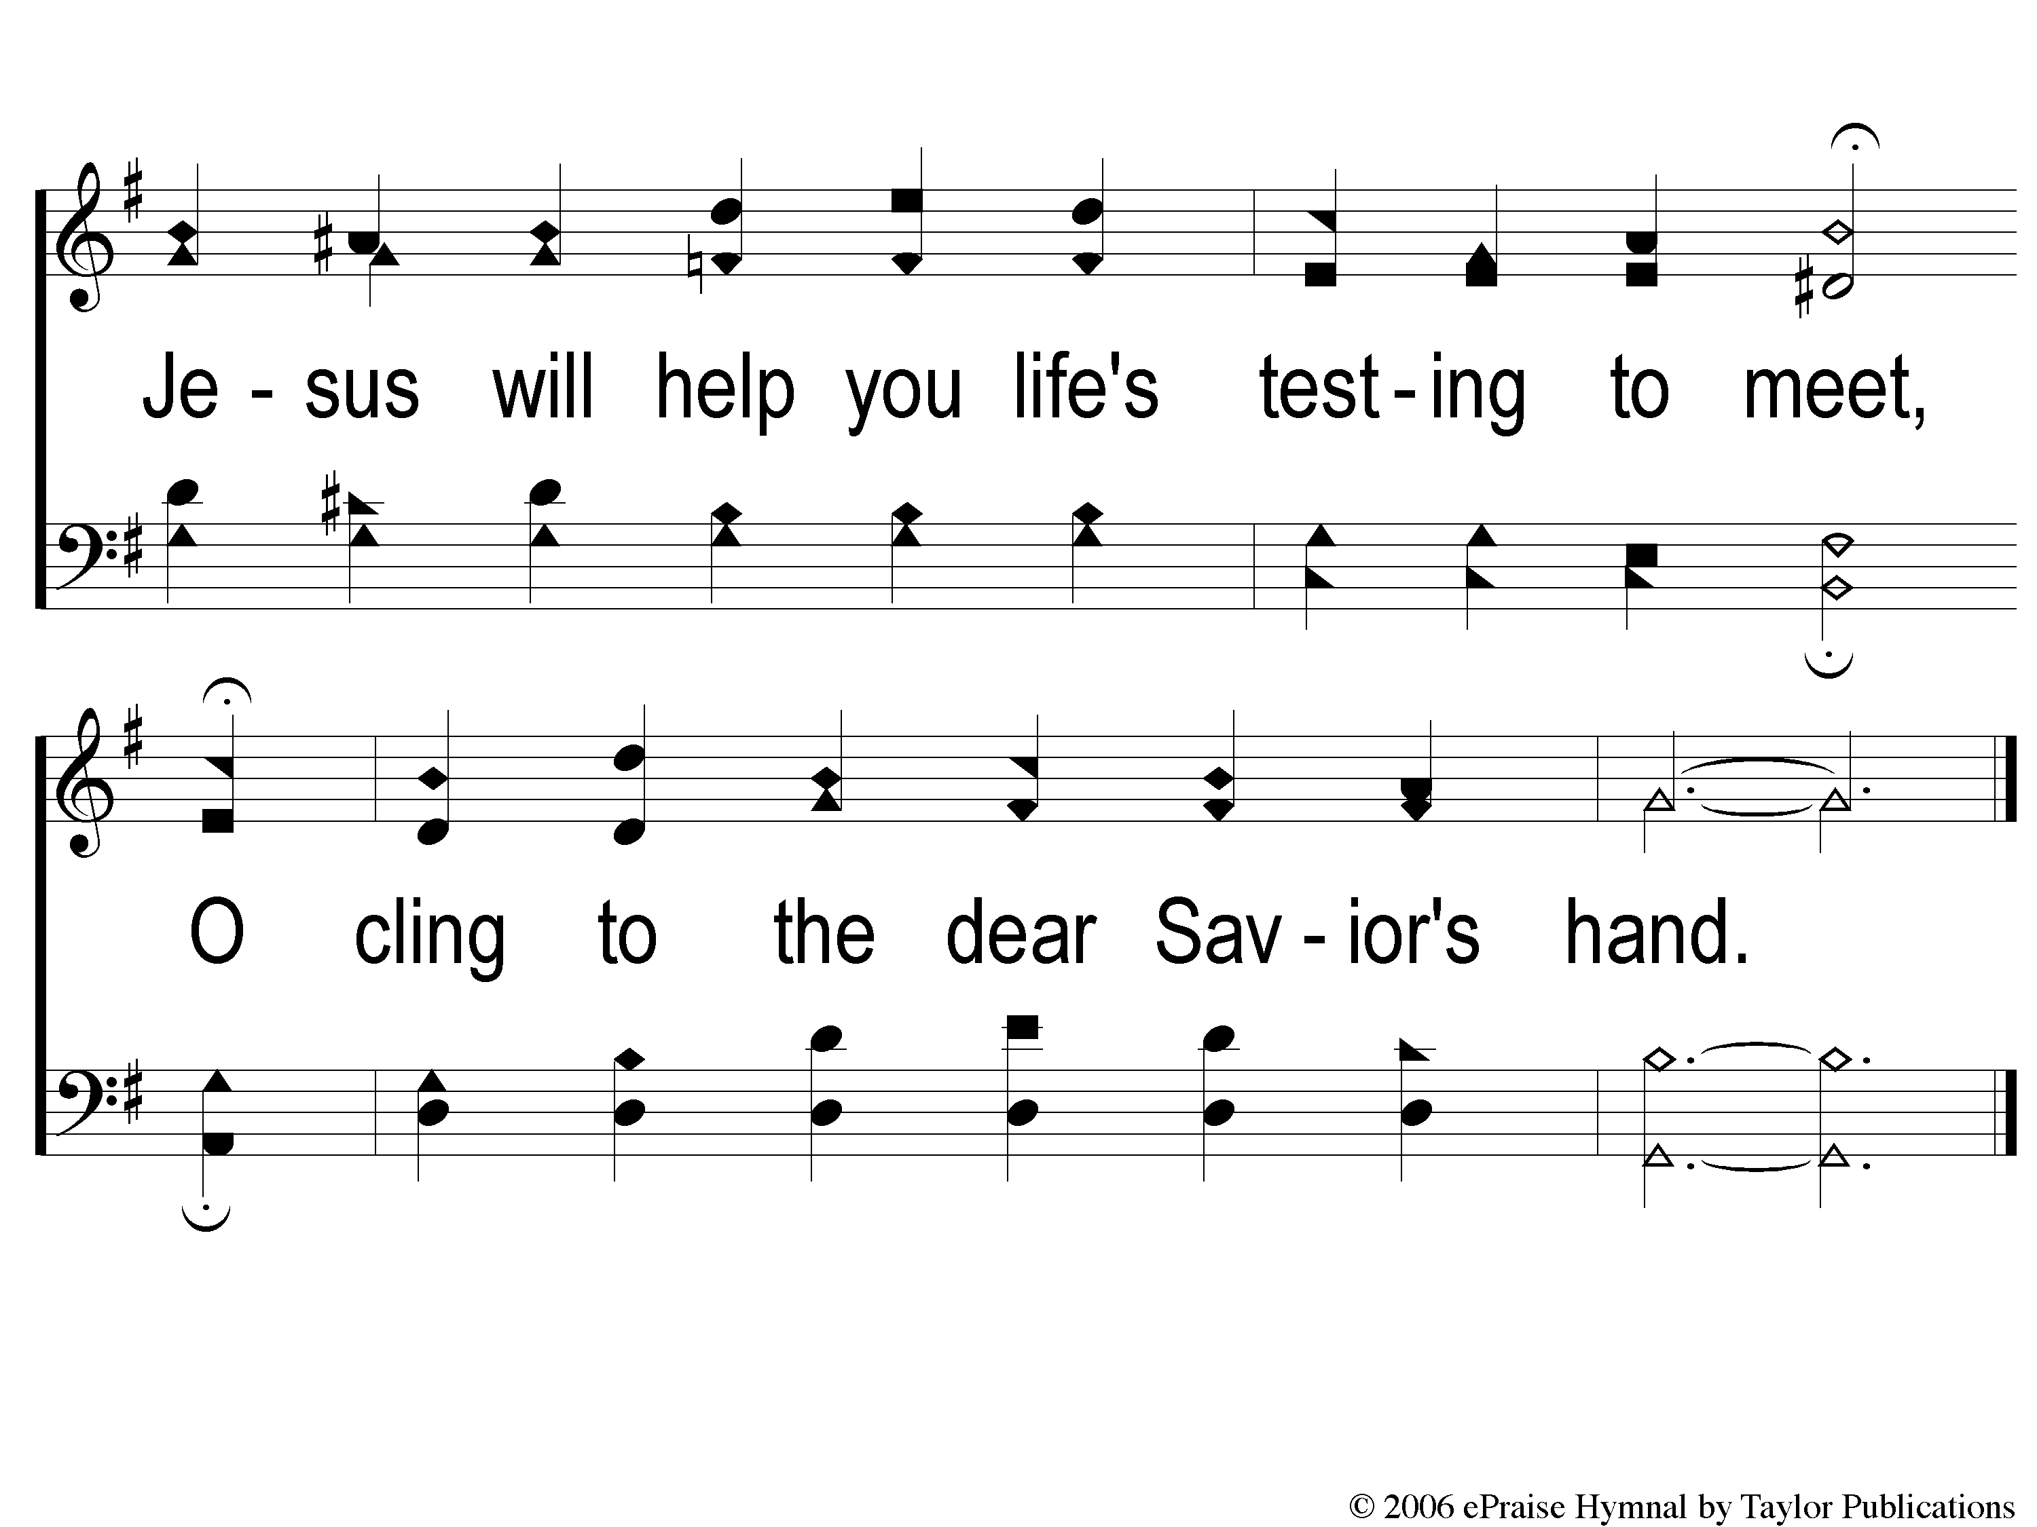
C-2 Cling to His Hand
Cling To His Hand
40

Slide 5
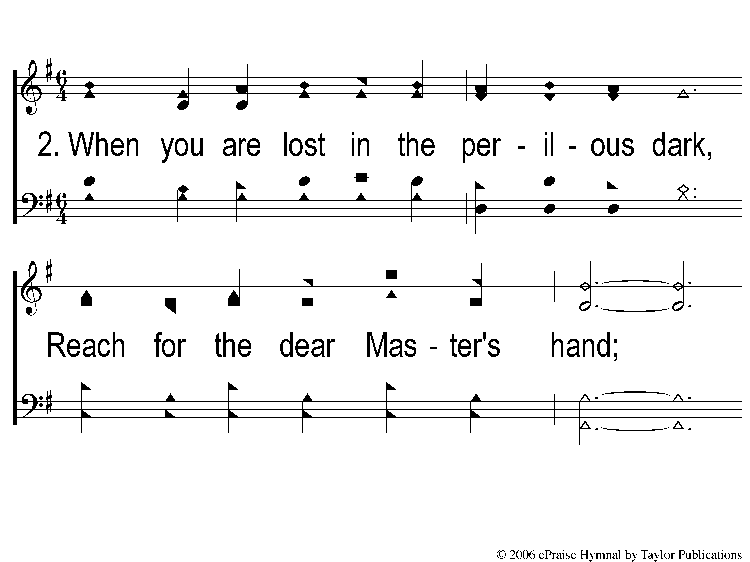
2-1 Cling to His Hand
Cling To His Hand
40

Slide 6
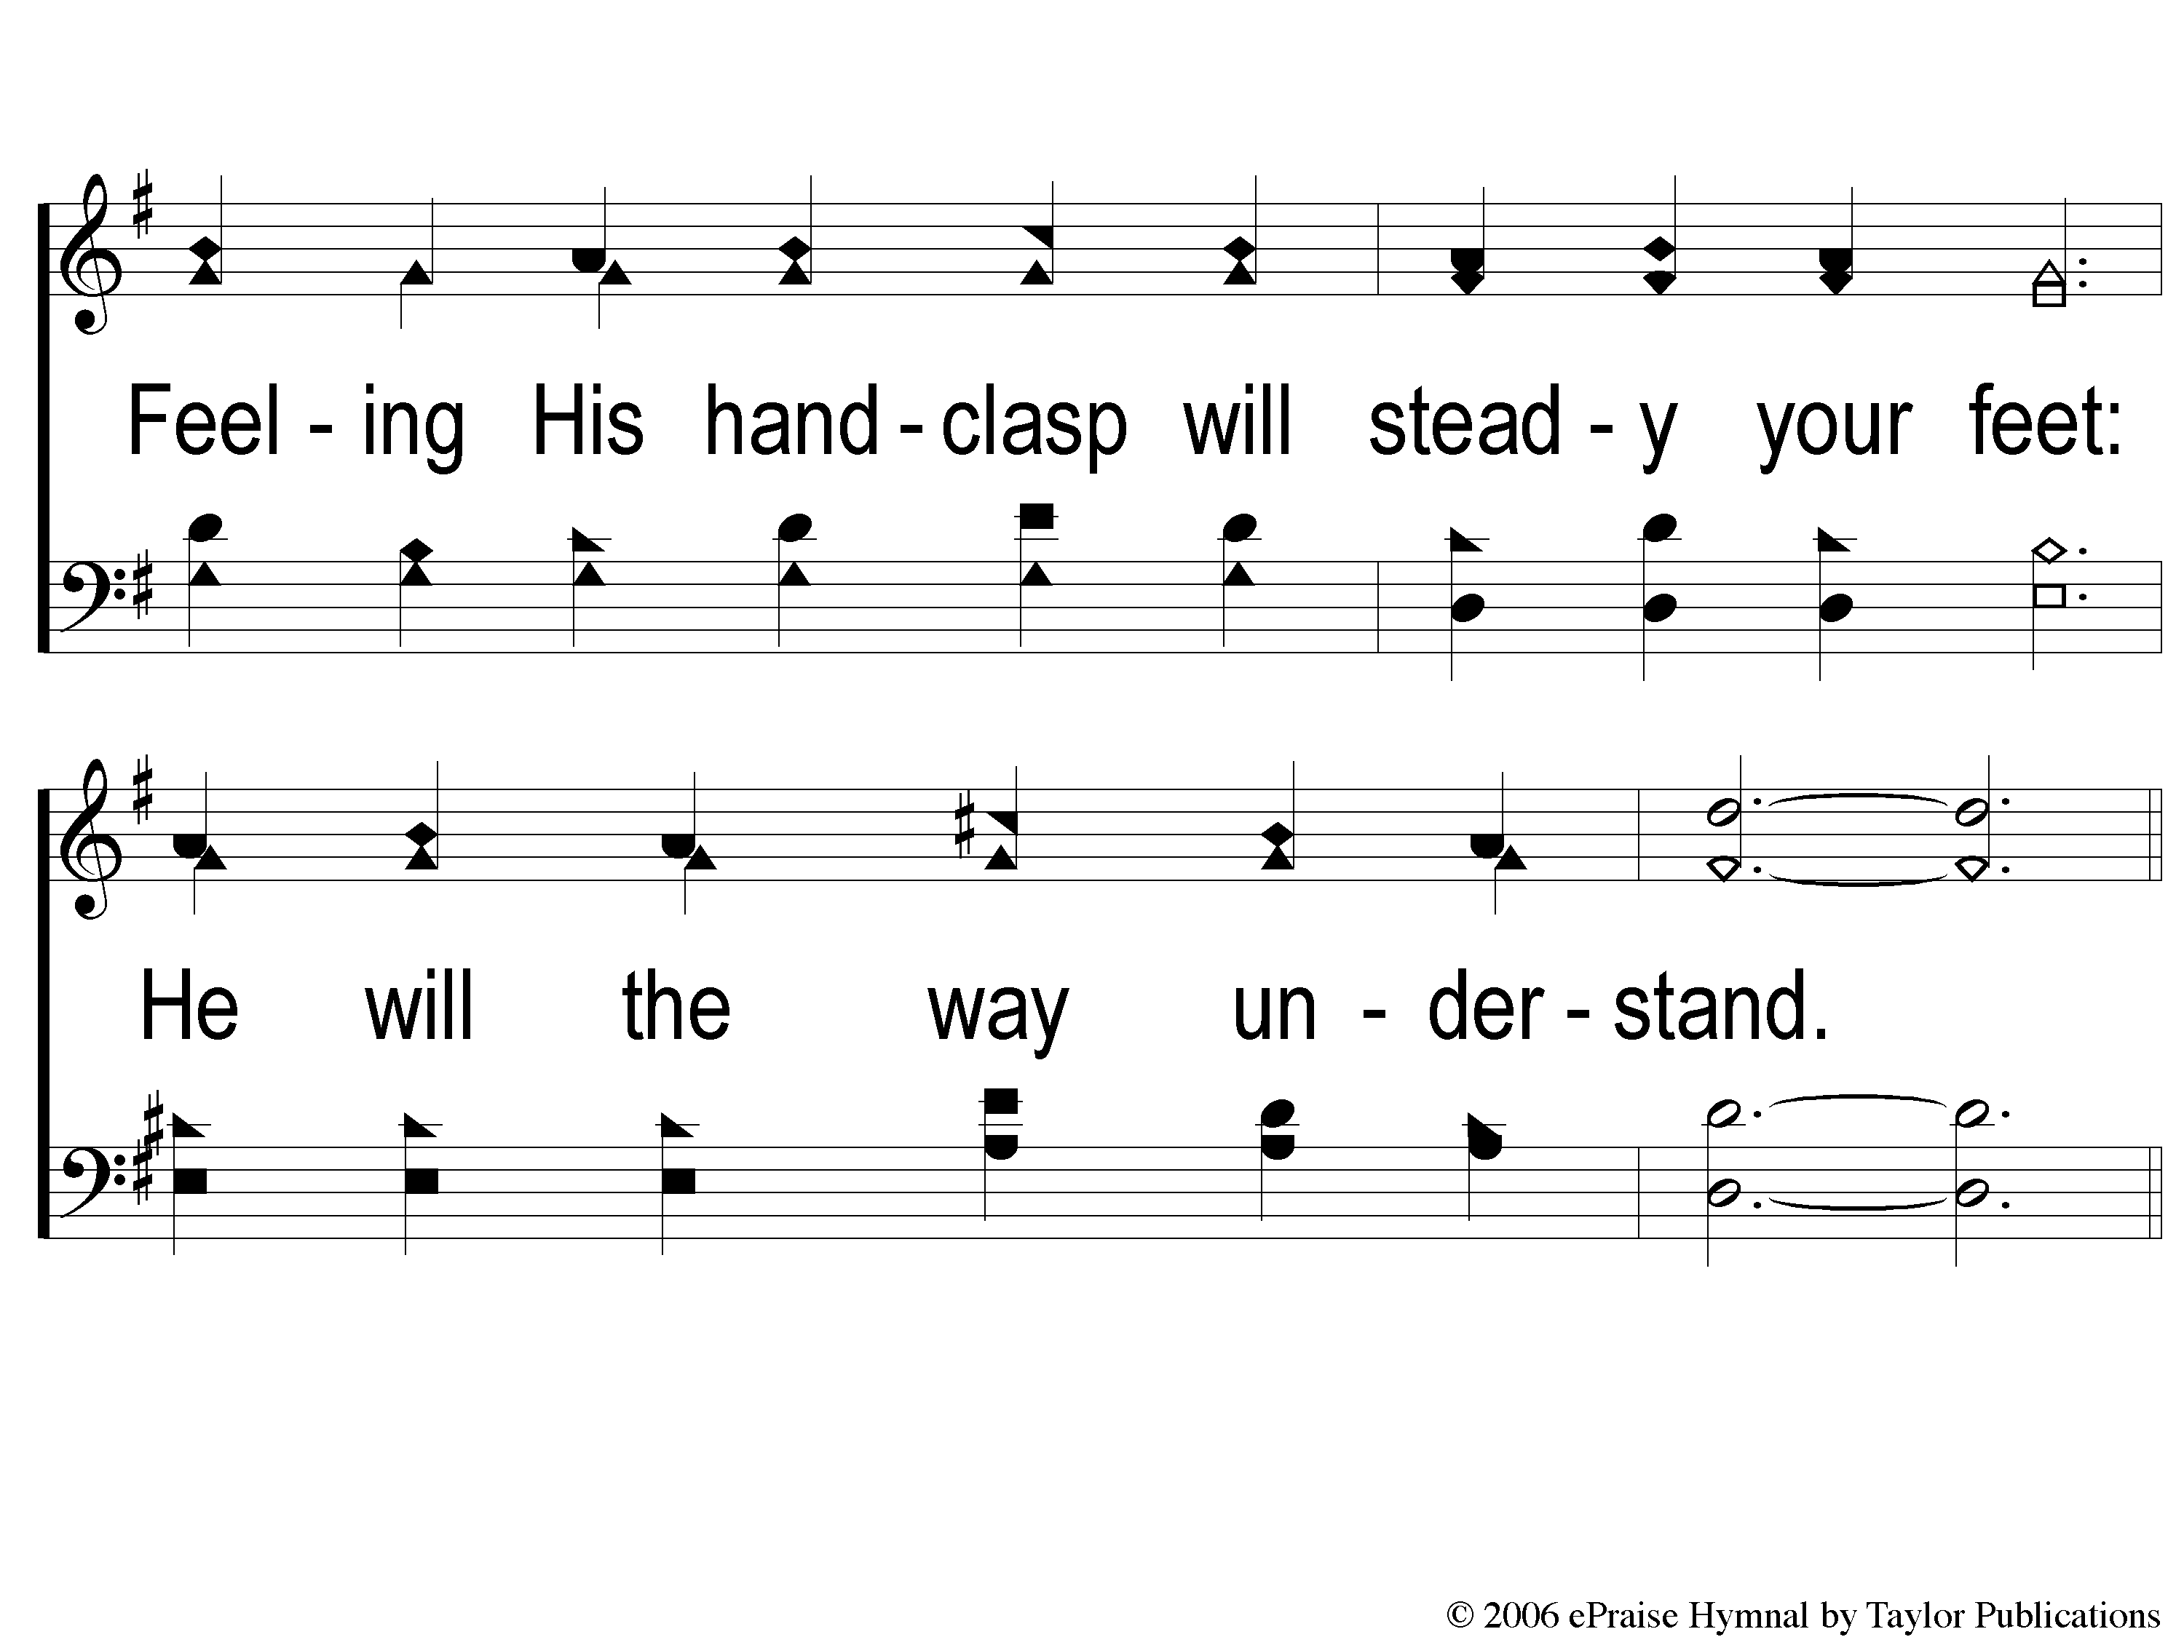
2-2 Cling to His Hand
Cling To His Hand
40

Slide 7
C-1 Cling to His Hand
Cling To His Hand
40

Slide 8
C-2 Cling to His Hand
Cling To His Hand
40

Slide 9
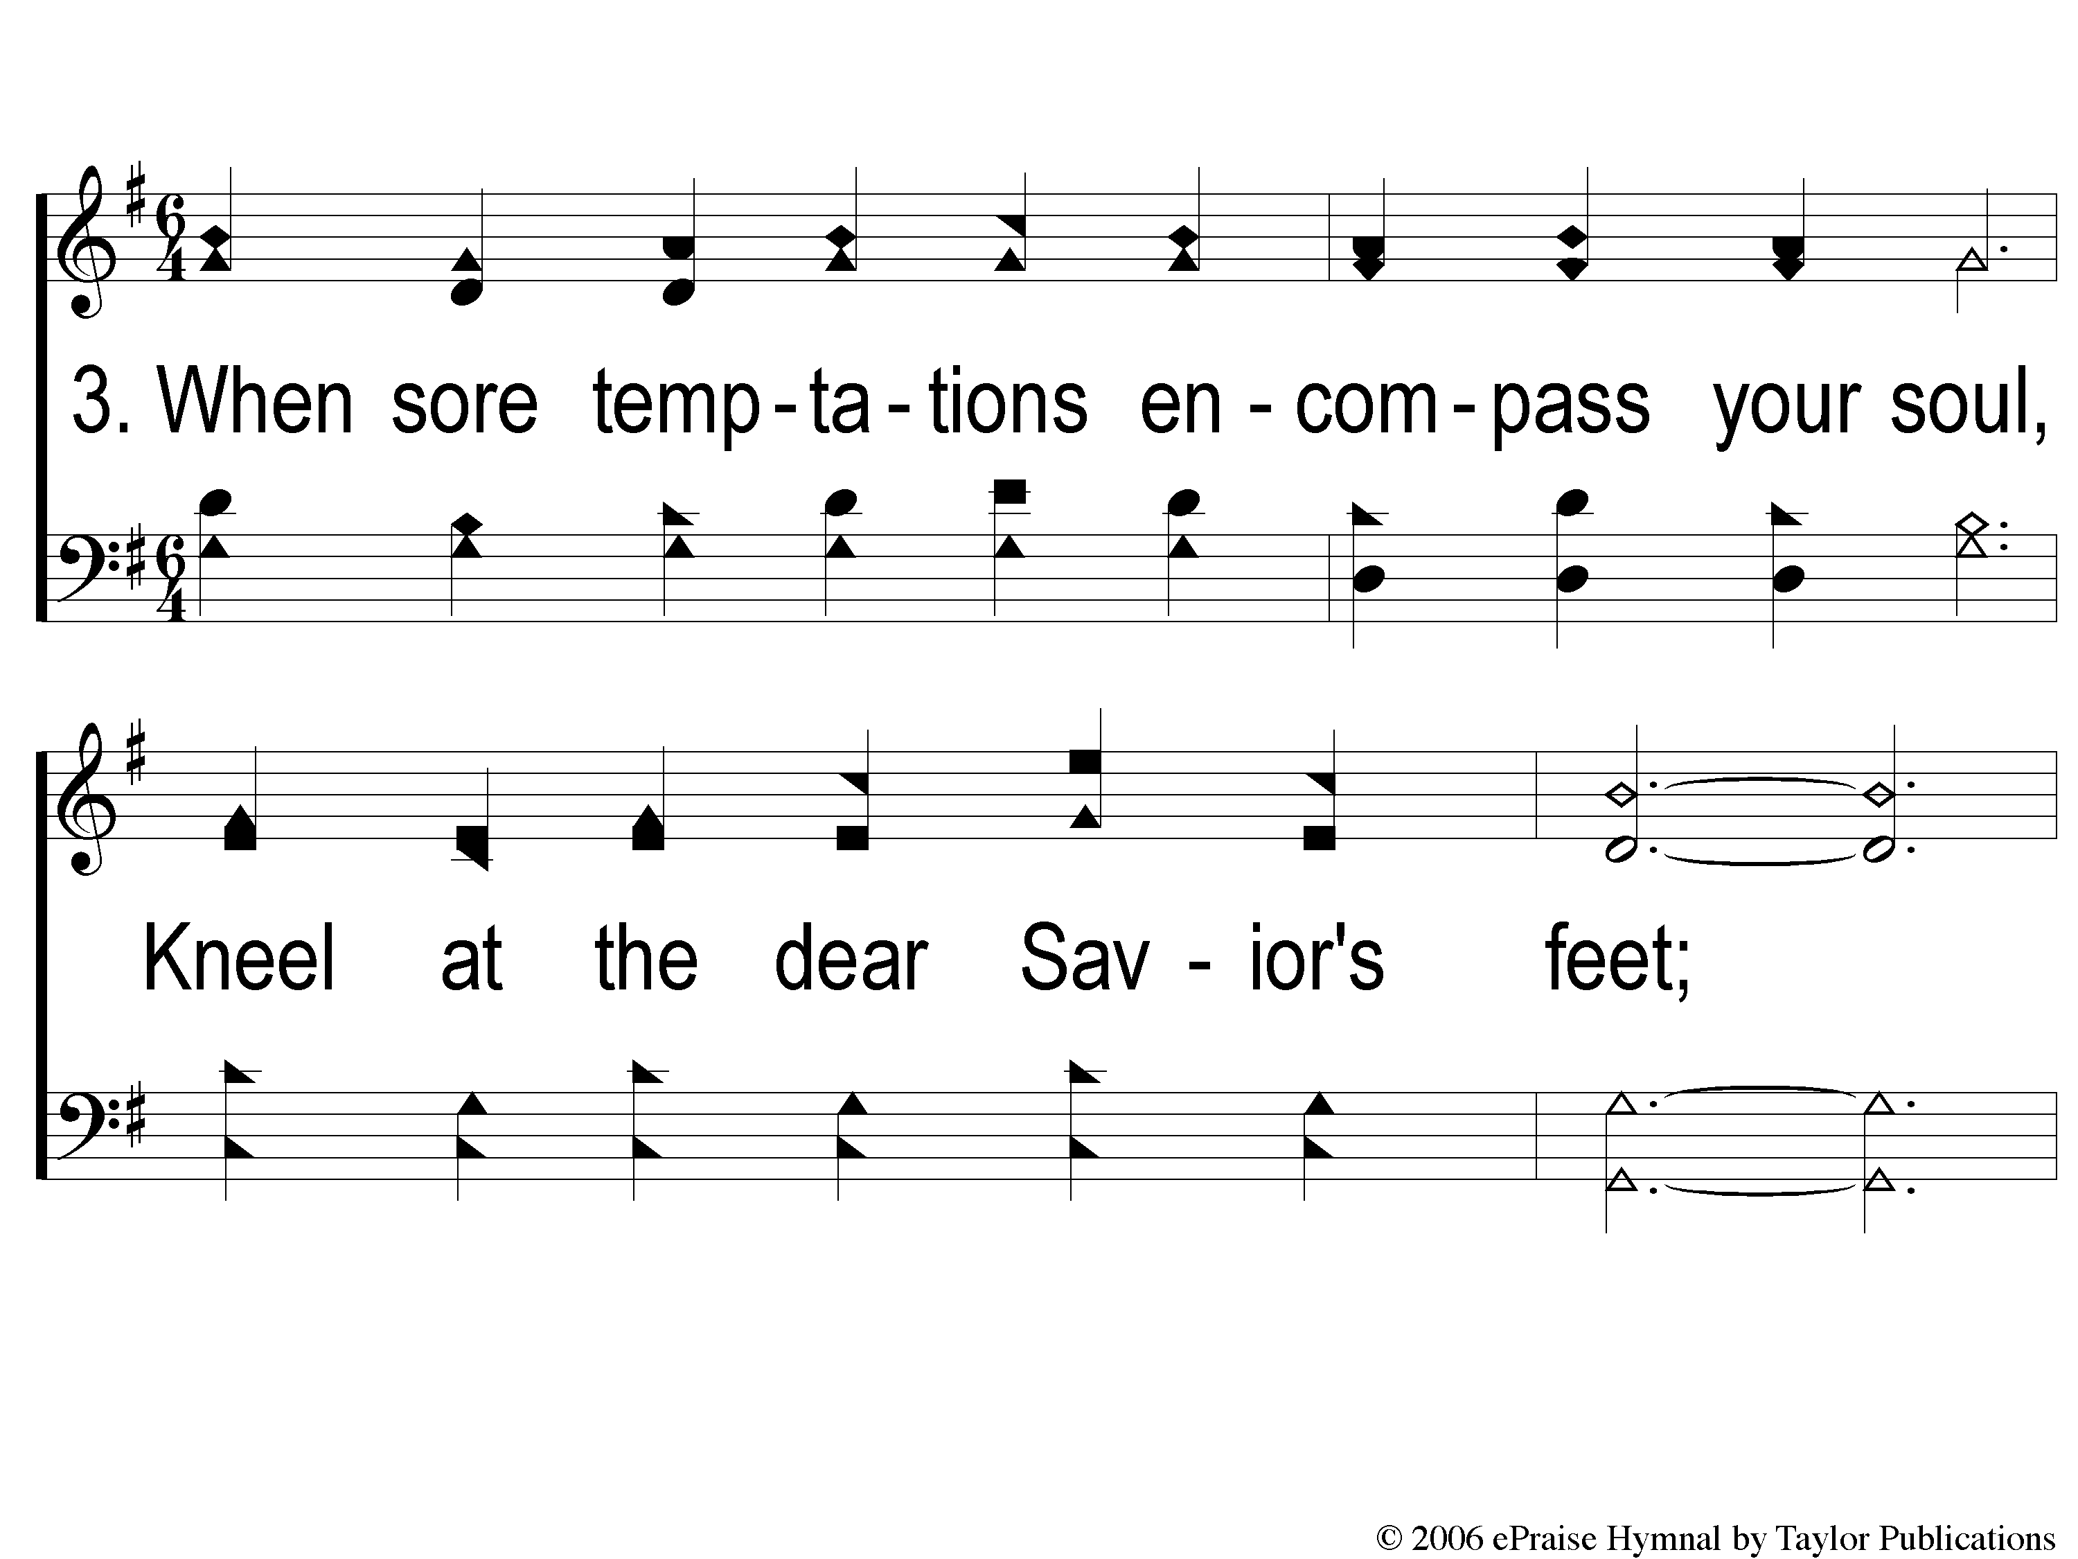
3-1 Cling to His Hand
Cling To His Hand
40

Slide 10
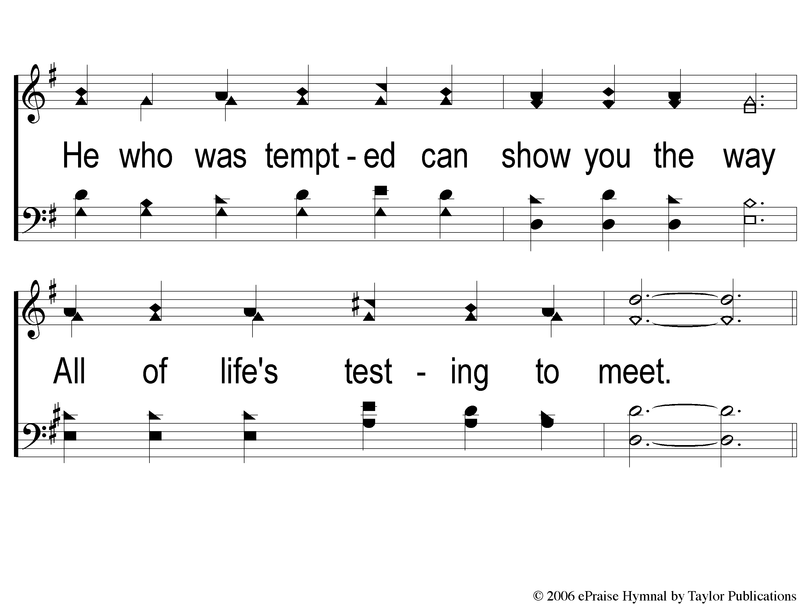
3-2 Cling to His Hand
Cling To His Hand
40

Slide 11
C-1 Cling to His Hand
Cling To His Hand
40

Slide 12
C-2 Cling to His Hand
Cling To His Hand
40

